Slide 1
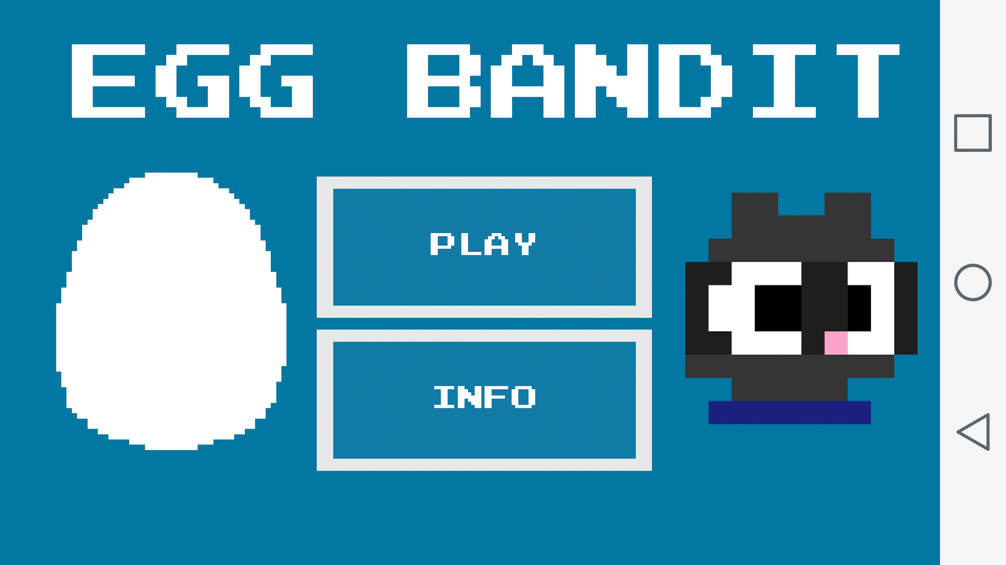
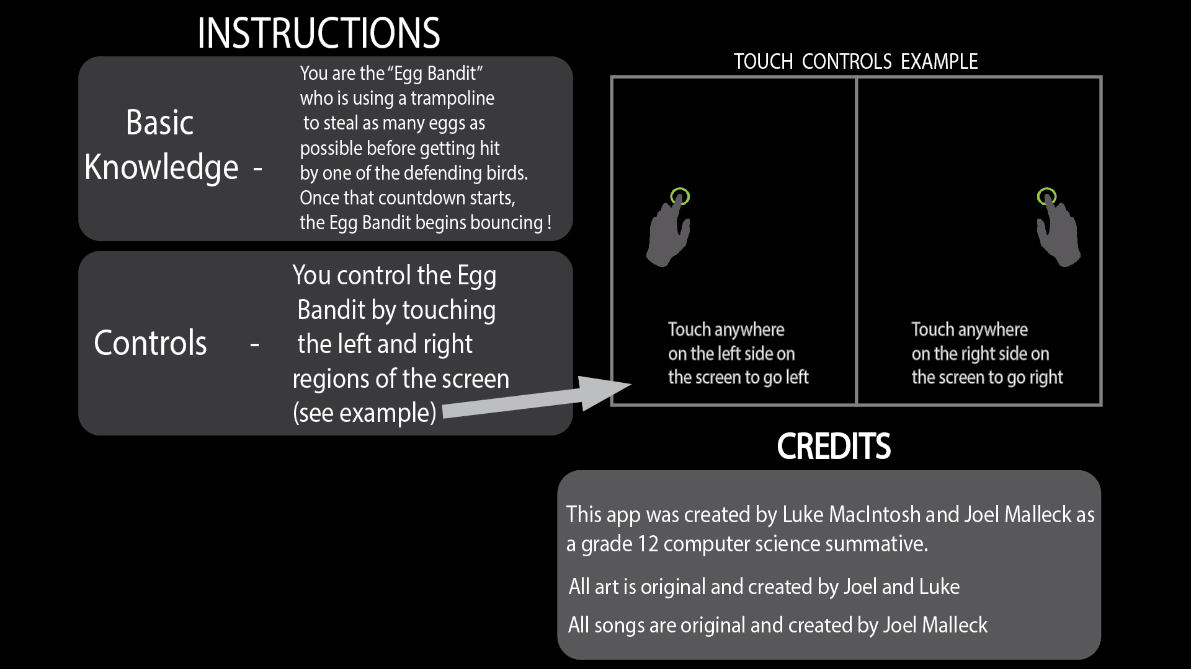
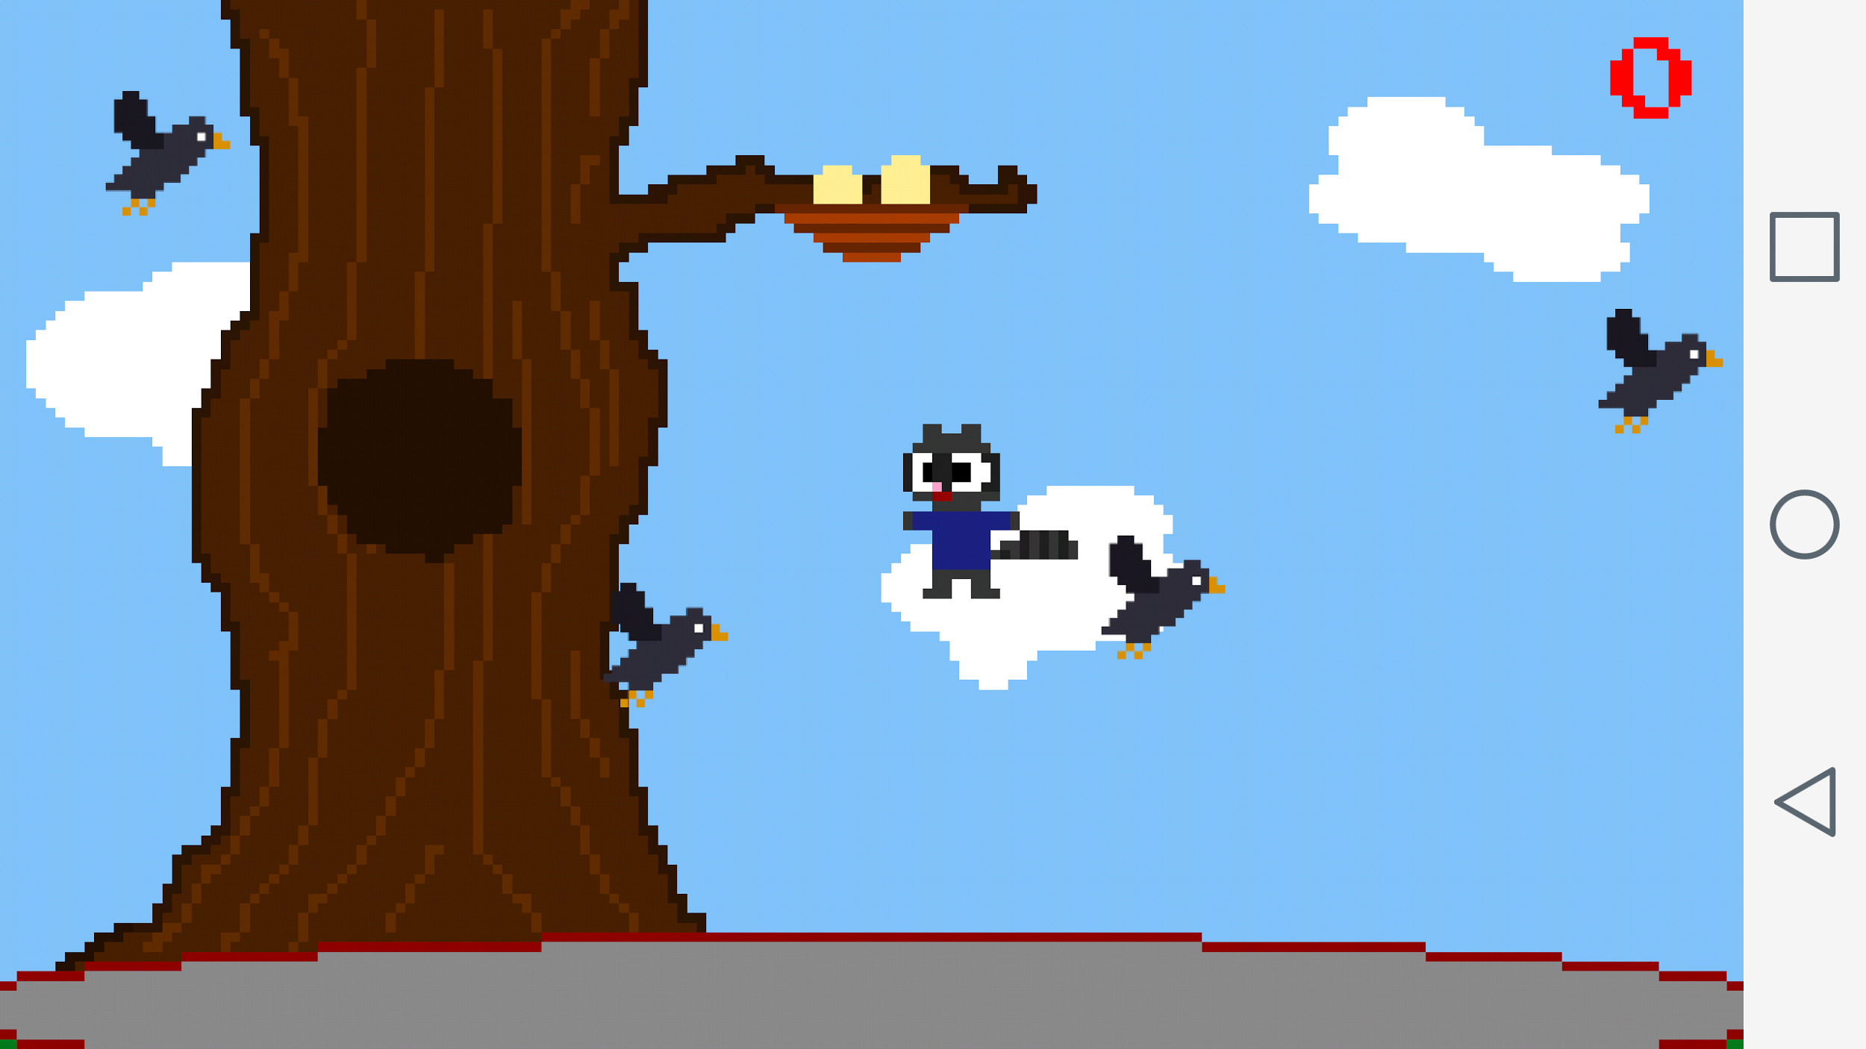
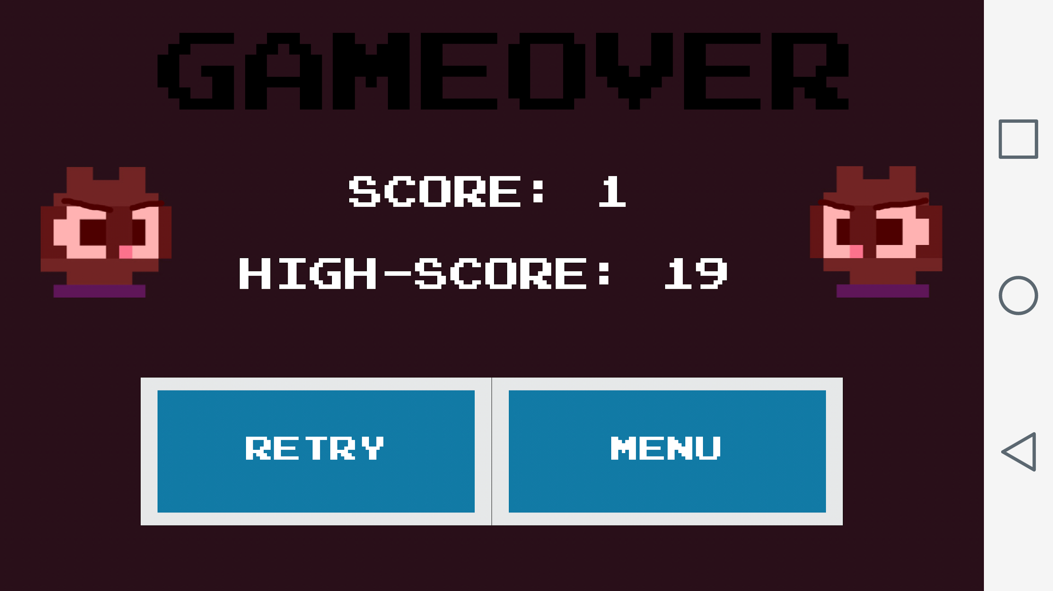
SCREEN SHOT HERE
EGG BANDIT
Created by the Smart Fellers team
SCREEN SHOT HERE

Slide 2

Egg Bandit Summary
The objective of the game is to collect as many eggs as possible. You control the Egg Bandit through touch region controls which are explained in the INFO section of the app. The Egg Bandit is always jumping because there is a trampoline on the map to help reach the eggs. Once the timer starts the Egg Bandit will jump continuously until you hit one of the birds. The birds are flying across the screen trying to stop you from collecting eggs. If a bird hits you, that's game-over and you'll have to try again to beat your score! Or your friends' scores !

Slide 3

Progression of Specs
-Double jump
-Dpad
-controlled jump
-no theme
-gyro feature
-objective(egg) x-values were random
-Character Auto Jump (Trampoline)
-Overall Game Theme
-Position of score increasing item
(in this case bird nest eggs)
-Movement System
-Gyro option excluded
-Simplicity

Slide 4
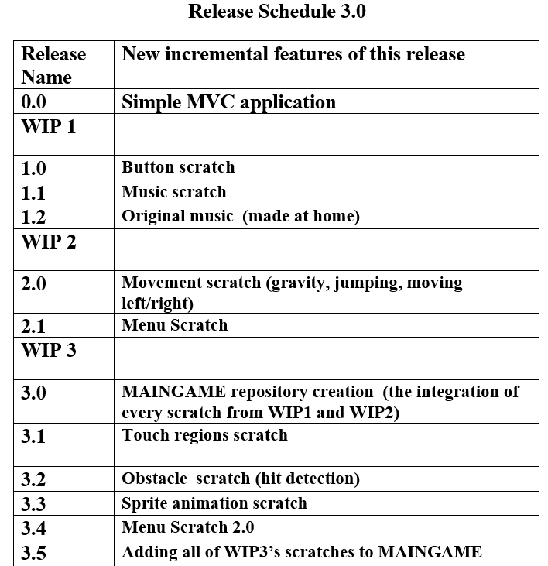
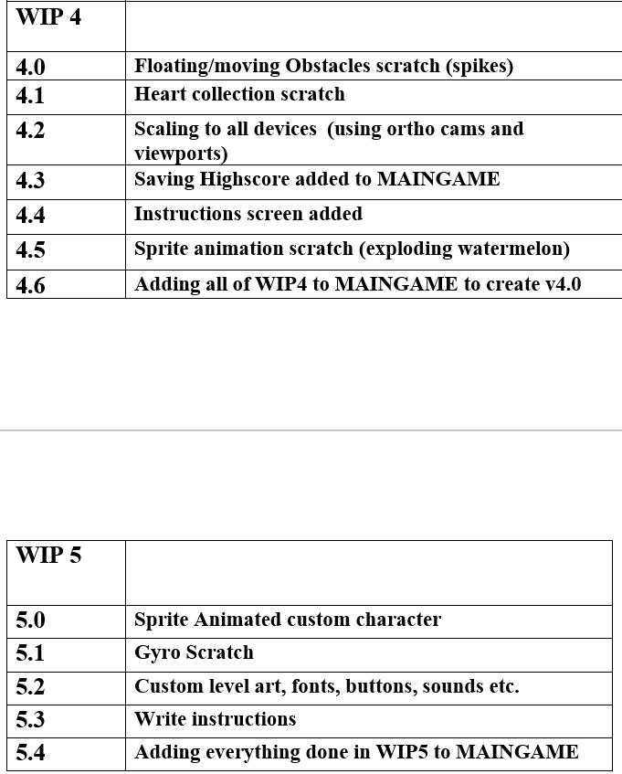
Release Schedule

Slide 5
RUN GAME !!!

Slide 6
Known Bugs
-Sounds drop after about 5 minutes of playing(fixed)
-Various animation glitches(fixed)
-Music Looping errors (fixed)
-Weird hit detection

Slide 7
Object Overview
9
Main - Deals with creating all the screens and switching between them
Obstacle - Deals with all the animations and hit detection for the birds and eggs.
Character - Deals with the movement, animations, and hit detection for the Egg Bandit(raccoon).
tbMenu and tbsMenu - Simple fast way to create custom buttons
4 different screen files - scrMenu, scrInstruct, scrPlay, scrGameover

Slide 8
Unique Challenges
-Creating original art and music was one of the biggest challenges
-Neither of us have great art backgrounds
-Music was easy with the help of the program pulseboy and some creativity - http://www.pulseboy.com/
-Art was made with the program Piskel - http://www.piskelapp.com/
-We ended up being happy with the result!

Slide 9
Why not Scene2D?
Using scene2d
“scene2d is a 2D scene graph for building applications and UIs using a hierarchy of actors”
https://github.com/libgdx/libgdx/wiki/Scene2d

Slide 10
New Programming techniques that were not taught in class
-Creating Physics + Boundaries
-Programming touch region movement
-Preferences
-Animation on hit

Slide 11
Preferences
Preferences = easy way to store small data in your application.
Examples on using preferences
Preferences prefs = Gdx.app.getPreferences("My Preferences");
prefs.putBoolean("soundOn", true); prefs.putInteger("highscore", 10);
prefs.putString("name", "Donald Trump");
if(nCurrentscore > prefs.getInteger(“highscore){
prefs.putInteger(“highscore”, currentscore);
}
if(sName == “donald Trump”){
prefs.putString(“name”, “Donald Drumpf”);
}
// Your changes to a preferences instance will only get persisted if you explicitly call the flush() method.
prefs.flush();
Easier but not the most efficient
Example - using Json instead

Slide 12
Biggest Frustrations
-Getting a proper touch movement method that would coordinate with sprites
-Scaling to all device sizes
-Problems switching between screens and the organization of all the screen files
-Creating a theme
-Creating art to match the theme

Slide 13
Notes to future programmers of your project
-Create different skins for the character and game background available to be unlocked
-Additional Music
-Improved physics
-Credits screen
-Worldwide leaderboards

Slide 14
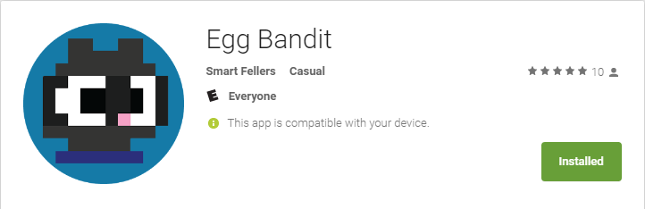
Uploaded to the Google Play Store
https://play.google.com/store/apps/details?id=com.mygdx.eggbandit&hl=en
SCREEN SHOT HERE

